Slide 1
Using ltspice from python
Tyler Hennen
2018-12-14

Slide 2
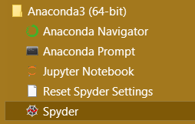
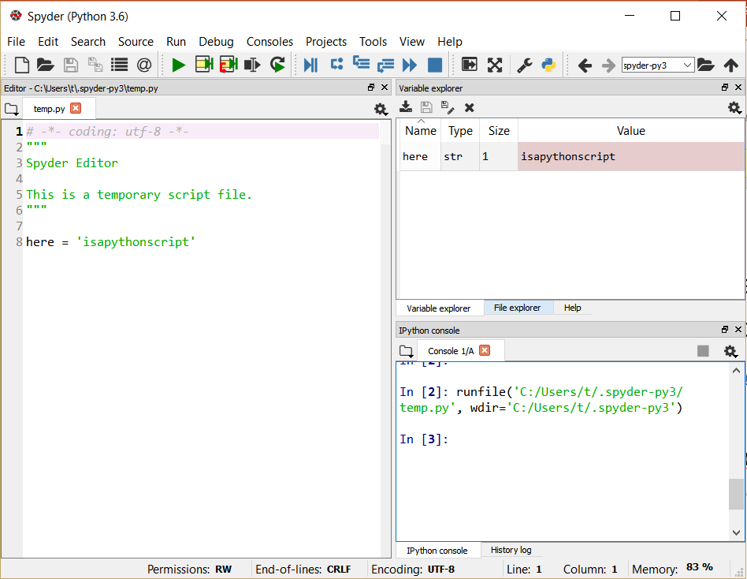
Installing python
There are many ways to install and use python
I use and recommend the latest anaconda distribution (python 3.7)
https://www.anaconda.com/download/
This comes with a huge number of scientific libraries that you’ll need
If you are used to the matlab interface, you can run Spyder, which is just a matlab clone that uses python code
Otherwise, python jupyter-qtconsole is a really nice enhanced console
When it’s time to graduate from Spyder, there are many fancy IDEs out there for python. I use vim/emacs but using something like pycharm would be easier to learn.

Slide 3
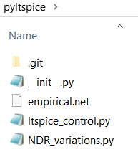
Pyltspice Git repo
Clone https://www.github.com/thennen/pyltspice
Or if you don’t have git, just click the link and download as a zip file, then install git for crying out loud
There are just a few files here, ltspice_control.py being the main one of interest

Slide 4
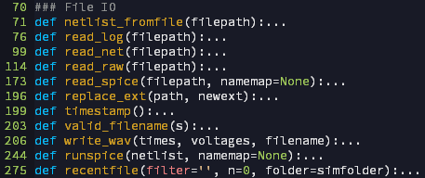
Project structure
The project is structured as a single module (file) simply containing a set of functions
The functions are organized roughly into categories
E.g. Functions that communicate with spice, and can read its data files:

Slide 5
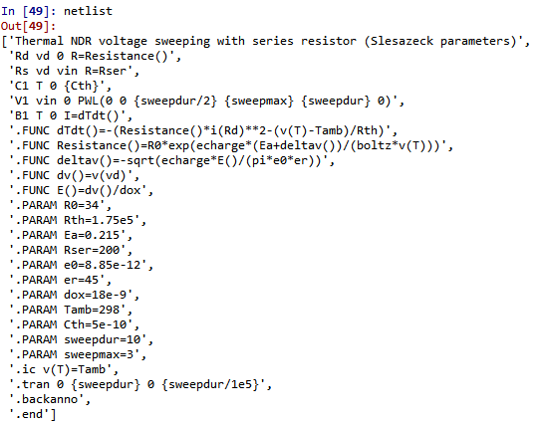
Netlists are represented in python as a list of strings:
You may write them directly in python code, or read them from a file using the function netlist_fromfile()

Slide 6

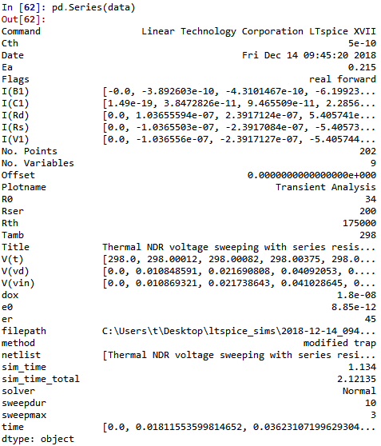
These netlists can be sent to the function runspice()
Then ltspice will run them, and the result data will be read from disk and returned:
Files are automatically written to the file system.
There is about a 1 second overhead per simulation to do the communication via file io.
“data” is now a python dictionary containing all the simulation parameters and results:
(converted to pd.series just for formatting)

Slide 7
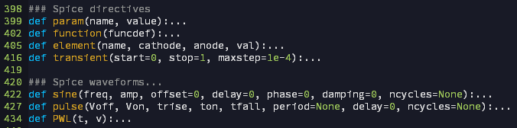

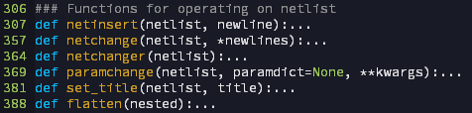
You could modify the python netlists directly through list and string operations…
But I also have a set of python functions that evaluate to spice code (strings)
Only some of the common spice commands are implemented currently, but you are welcome to extend it
e.g.
Then there are functions for inserting new commands into existing netlists
Input netlists are never modified, new netlists are always returned by the functions

Slide 8
Examples

Slide 9
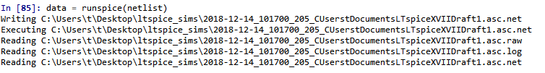
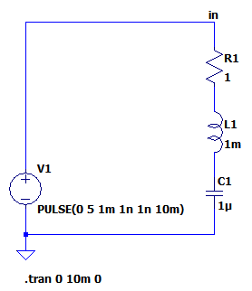
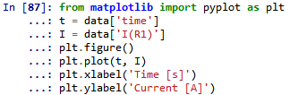
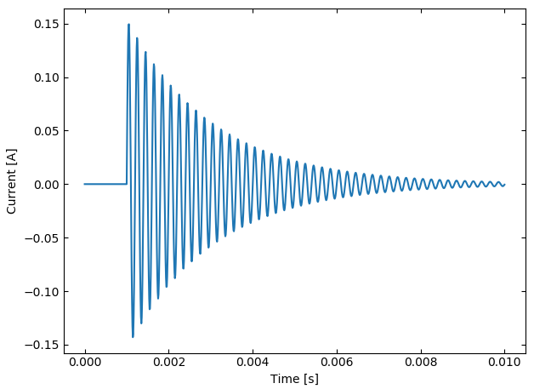
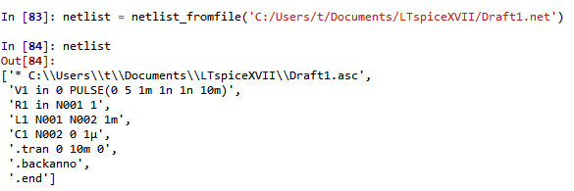
Basic example:
3. Run the netlist from python and make a plot
Draw a neat circuit
2. Import the netlist into python

Slide 10
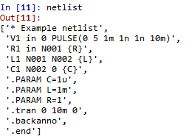
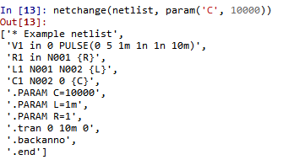
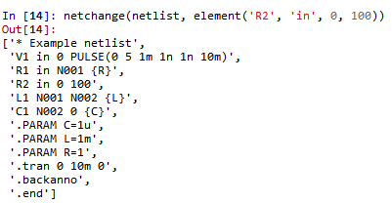
Changing netlists
The main function to use is netchange()
netchange() decides whether to add new lines to the netlist or to replace existing lines
Original netlist
Change a parameter:
Add an element:

Slide 11
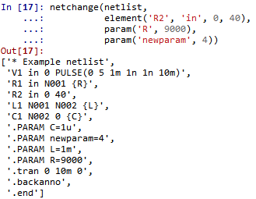
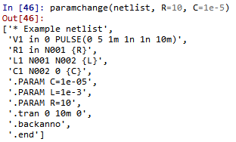
Changing netlists
You can add as many lines as you want at a time
If you are just changing .PARAM statements, there is a function with a nicer syntax:

Slide 12
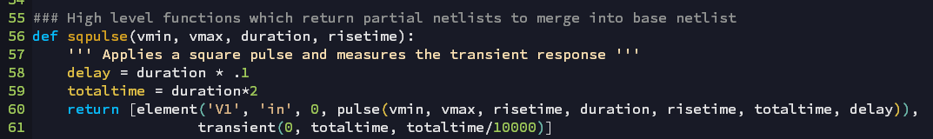

You can create convenient functions that correspond to multiple lines in spice, and add them at once

Slide 13
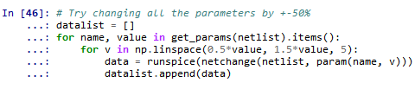
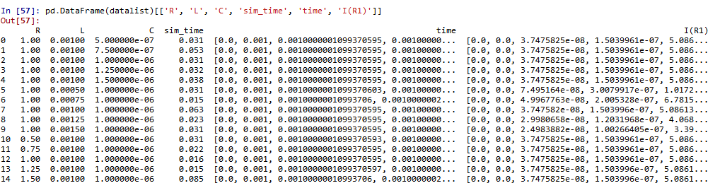
Another example
Results:

Slide 14

Errors
Error handling is not very good yet
If you write an error in your netlist, sometimes python just hangs while it waits for ltspice to respond
In this case, use task manager to end the SPICE Simulator

